Slide 1
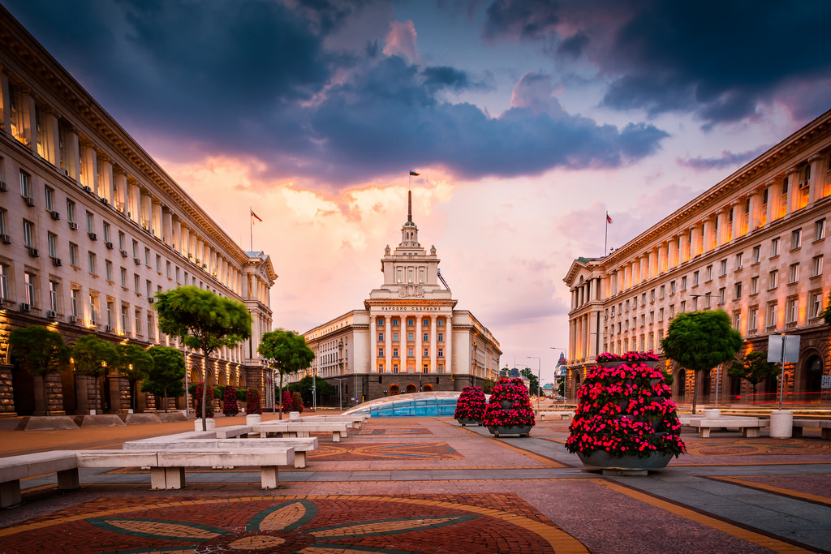



Viktor Velev, Vladislav Georgiev, Kaloyan Madjunov
Martin Datsev, Petar Milev, Telerik Arsov

Slide 2


THE PROBLEM
The difficult tourists orientation in Sofia
The difficulty of finding a place to live

Slide 3
THE Solution
Fast user friendly analysis of Sofia
Population density
Sport facilities
Best quarters to live in

Slide 4

The Technologies
NLTK
NumPy
Selenium
GloVe – Stanford NLP
GenSim
Pandas
TextBlob

Slide 5

The Data assimilation
Airbnb API
Tripadvisor API
Dataset with a polyon of the quarters in Sofia

Slide 6
Exploring the data
Sentiment analysis
Topic modelling
Scoring locations by topics

Slide 7

A HUMAN-LIKE SEARCH
Natural input
Search terms extraction
Comparing by meaning

Slide 8

Time for demo

Slide 9
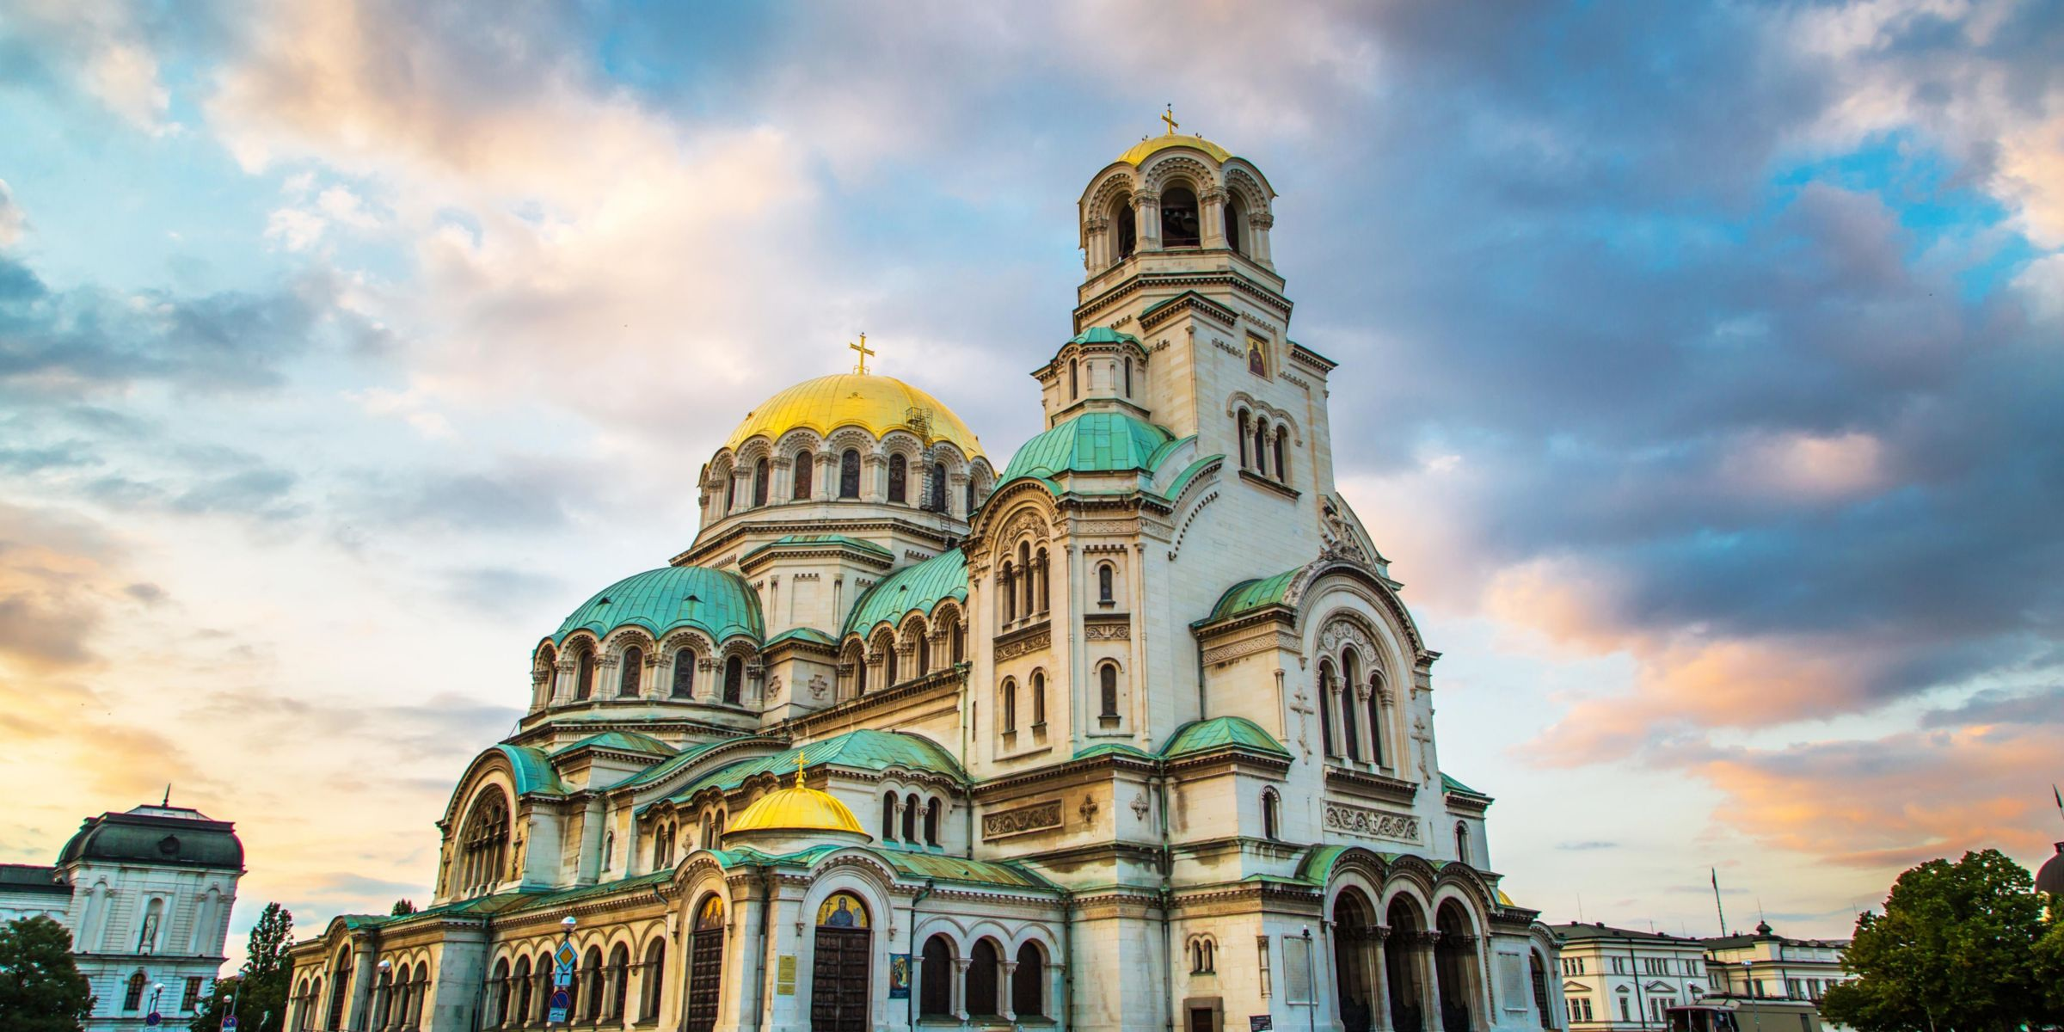



THE FUTURE

Slide 10


Summary
The Problem
The Solution
The Technologies
The Data Assimilation
Exploring the data
A Human-like Search
Time for Demo
The Future

Slide 11


